Slide 1
Schema.org Extensions for IoT (iotschema)
2nd W3C Web of Things Workshop
Michael Koster, Darko Anicic, Aparna Thuluva

Slide 2
What is iotschema ?
An open, publicly available, repository of semantic definitions for connected things
An extension of schema.org to enable descriptions of things in the physical world and their data
A community process for contribution and publication of standardized definitions
A way for domain experts to easily create semantic definitions that are relevant to their application domain

Slide 3
What is iotschema (2)
A layer to bridge between device ecosystems and Semantic Web technologies
Normalize the device definitions from OCF, oneM2M etc.
Reuses property and relation types from existing ontologies and definitions
SSN, SOSA, SAREF, QUDT
Property types for e.g. Feature of Interest, units of measurement
Annotation vocabulary for WoT Thing Description
Common definitions for application-specific Events, Actions, and Properties

Slide 4
Diverse Devices and Applications, Common Protocols and Semantics
Diverse Applications
Applications
Interoperable Applications
Semantic Vocab
iotschema
Web of Things
Narrow Waist
of Semantics
Thing Description
W3C Thing Description
Protocol Binding
Diverse Devices
Device Ecosystems
OCF, OMA, Zigbee, Fairhair
Protocols, Formats
IETF CoAP, CBOR, Link-Format
Internet of Things
Narrow Waist
of Protocols
Transport
UDP/TCP
Networks
WiFi, IPV6, Bluetooth

Slide 5
Who is iotschema for? For Different IoT Actors
Device vendors will use iotschema to publish protocol-neutral definitions of their devices to enable web scale adoption
IoT platform providers will use iotschema to make it easy for third party applications to use the platform
Application providers will use iotschema to make their applications portable across platforms
Domain experts will use iotschema to create domain-specific languages for connected things and their applications

Slide 6
iotschema Semantic Definitions
Semantic definitions that follow the design patterns and interaction affordances of connected things
Define a "Capability" that represents – typically – the smallest practical compose-able unit of functionality
For example, a temperature sensor, or a door lock

Slide 7
iotschema Semantic Definitions
iotschema semantic definitions consist of three categories, or classes, that describe a measurement or actuation, of some physical property or item
A Capability describes measurement and actuation of some physical variable or set of variables, for example the temperature of something, or the brightness of a light bulb. A Capability has some related Interactions.
An Interaction (Event, Action, or Property) describes an affordance to the capability, which may be to read or write a value, or perform a complex action.
Data Item descriptions contain data types, units, minimum and maximum values, and other information about the data model, for example a shape or schema

Slide 8
iotschema Model
schema:thing
providesOutputData
providesInteractionPattern
acceptsInputData
Capability
InteractionPattern
DataItem
schema:PropertyValue
Action
Event
Property
schema:PropertyValueSpec.
rdfs:subclassOf
schema:Property
iotschema Class
Reused Class

Slide 9
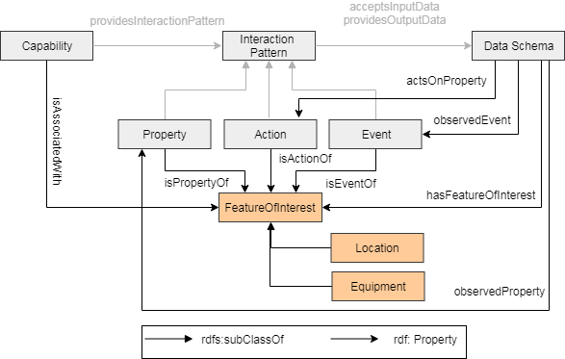
Feature Of Interest Pattern
iotschema defines relationships between Capabilities and Features of Interest to describe connected physical systems

Slide 10
iotschema Conceptual Integration with other ontologies
SSN, SOSA, SAREF concepts can extend a definition
Feature of Interest concepts and property types to describe location, equipment, or other classifiers
For example: BrickSchema definitions from Haystack
Quantity and Units constraints can use QUDT concepts and appropriate identifiers

Slide 11
Connect things to the real world
"Lock Security Doors and Check"
DoorLock Capability
- ActuateLock Interaction
- ActuateUnlock Interaction
- GetState Interaction -> LockState Data
Door Lock
isAssociatedWith
iotschema.org
Door
- Is A Front Door
- Opens To Outside
- Is A Security Door
other ontologies

Slide 12
How is iotschema used?
Annotation of Thing Descriptions (W3C Web of Things)
A Thing Description represents a thing that can be annotated with iotschema capability terms
Thing Descriptions have Action, Event, and Property Interaction definitions that can be annotated with iotschema Interaction class terms
Thing Descriptions have DataSchema elements that can be annotated with iotschema Data Item class terms and constraints, such as data type, units
Thing Description enables applications to interact with connected things independent of protocol and platform

Slide 13
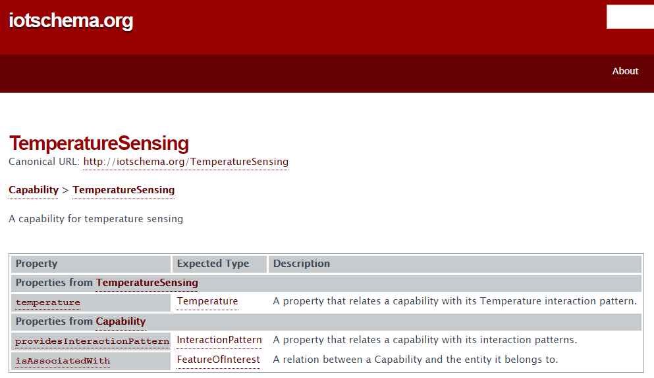
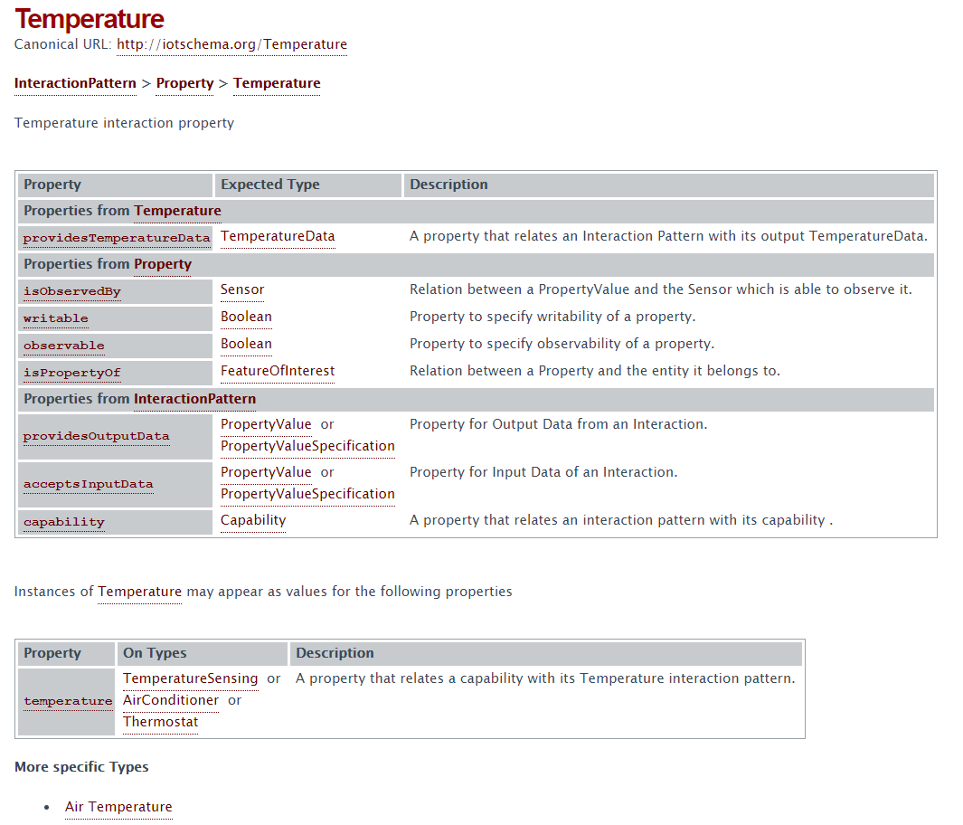
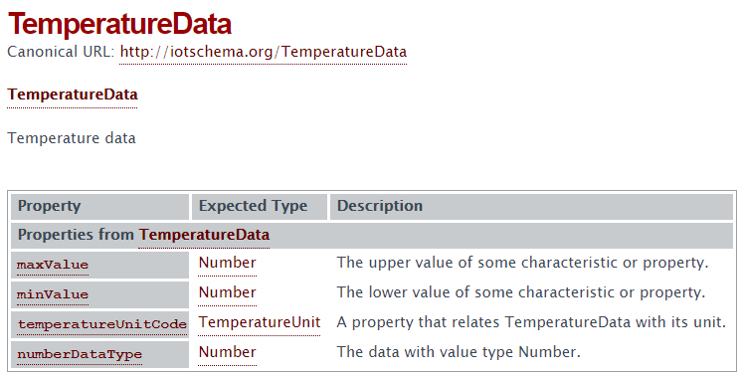
How is iotschema used?
Capability
Interaction Pattern
Data Schema

Slide 14
Thing Description Example
{ "@context": [ {"iot": http://iotschema.org/ } ],
"@type": ["Thing", "iot:TemperatureSensing"],
"name": "TemperatureSensor",
"iot:isAssociatedWith" : {"@id": "31.636", "@type": "iot:Room"},
“properties": {
“currentTemperature” : {
"@type": ["iot:Temperature"],
"isPropertyOf": {"@id": "31.636", "@type": "iot:Room"},
“properties": { "type":"number",
“schema:minValue": 0, “schema:maxValue” : 50,
“schema:unitCode”:”iot:Celsius” },
….
} ] }

Slide 15
iotschema Node-RED

Slide 16
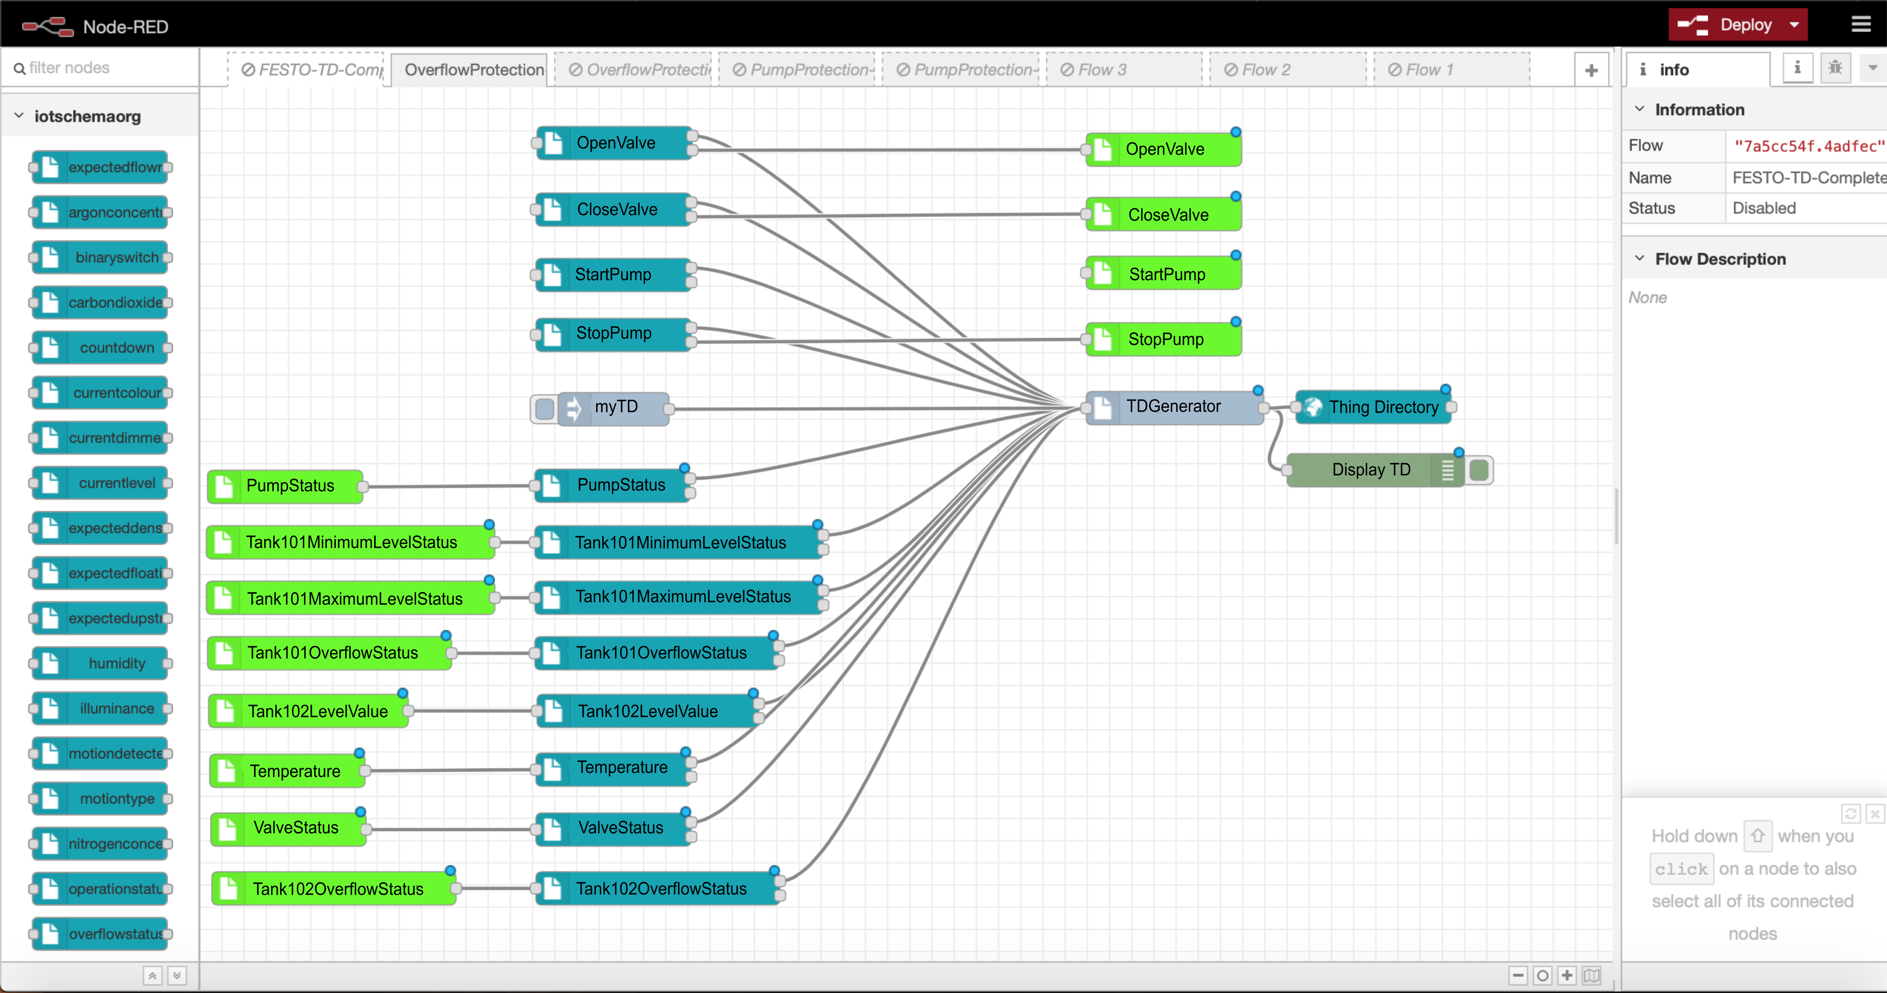
iotschema Node-RED

Slide 17
Status
Monthly Teleconferences since mid-2017
Examples of Definitions in a Github repository
FoI annotation examples are also in the repo
Prototypes tested at W3C Web of Things Plugfests and WISHI/IETF Hackathons from mid 2017
Contributors are ready to begin submitting definitions
Next steps are to build out tools and processes
W3C Community Group

Slide 18
References
iotschema links
https://github.com/iot-schema-collab/teleconferences/blob/master/README.md
https://github.com/iot-schema-collab/intro-materials
https://github.com/iot-schema-collab/teleconferences
iotschema Node-RED project
https://github.com/iot-schema-collab/iotschema-node-red
W3C Community Group
https://www.w3.org/community/iotschema/
Provides an IPR framework for contribution

Slide 19
Thank you

Slide 20
Narrow Waist in System Design
App
App
App
App
Many Applications. Local and Remote
Web of Things
Semantic Interoperability (Software Adaptation)
Common Infrastructure
(Protocols, Formats, and Meta Models)
Internet of Things
IP Networks LAN/WAN (WiFi, Thread)
Fairhair
OCF
dotdot
LWM2M
Many Devices, Different Ecosystems

Slide 21
Feature of Interest Integration
Features Of Interest (FoI) describe the real-world targets of sensing and actuation
Definitions may be developed in iot.schema.org, or more likely will come from domain experts
GENIVI/VSS is a Specification for Automotive Features of Interest, called Branches, and actuation/measurement points, called Attributes and Signals
BrickSchema is an adaptation of Haystack that defines Features of Interest of buildings and actuation or measurement points
iotschema defines relationships between Capabilities and Features of Interest to describe connected physical systems

